Slide 1

Data extraction and transformation

Slide 2

Data extraction and transformation
1
Power BI desktop Installation
2
Data Transformation

Slide 3
Power BI Installation

Slide 4
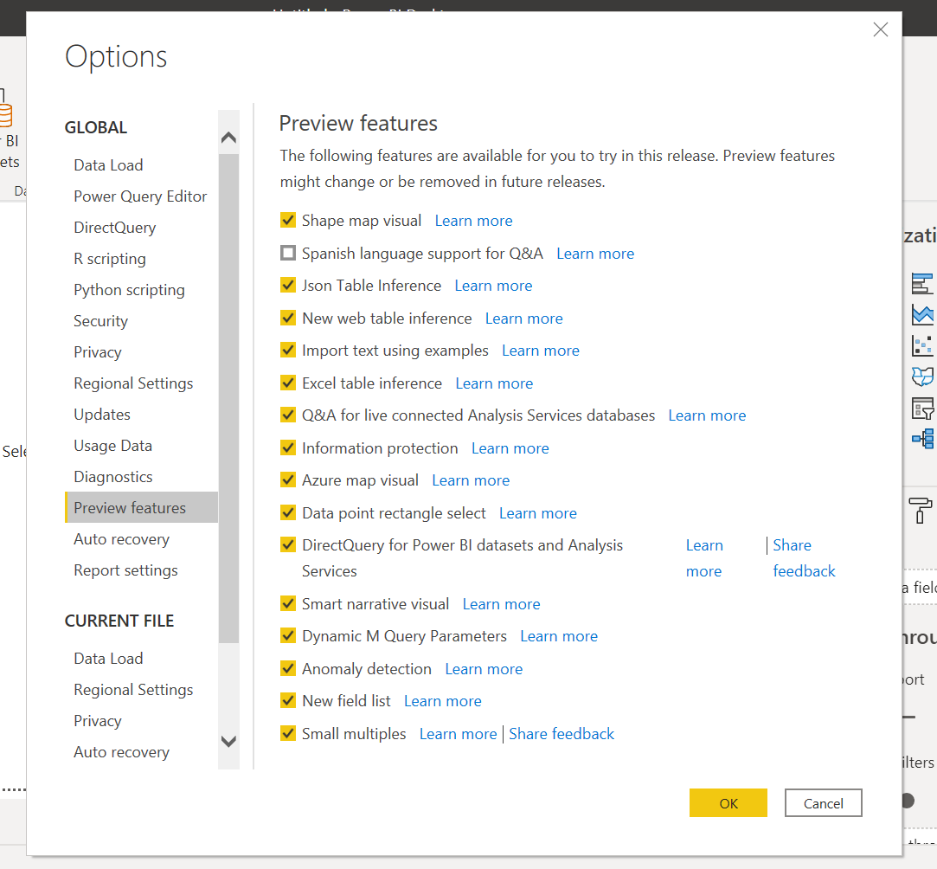
Power BI Installation
Install Power BI Desktop: https://www.microsoft.com/en-us/download/details.aspx?id=58494
Language: English;

Slide 5
Data Transformation

Slide 6
Data Transformation
Data Sources
Advanced Editor;
Rename Query
Duplicate column
Change data type
Work with date;
Split column;
Create groups and queries;
Create new columns:
Conditional column;
Column from Example;
Custom column;
Index column;

Slide 7
Data Transformation
Load data from folder;
Append queries;
Custom column;
Merge queries;
Query dependences;
Load excel file;
Query parameter;

Slide 8
Data Transformation
Create function with parameter;
Invoke custom function;
Pivot/unpivot data;
Filtering out values;
Replacing data;
Create new query by list of values;
Enter data in new query;
Create new query by column from another;
Working with duplicates;
Working with fact and dimensions;

